Slide 1

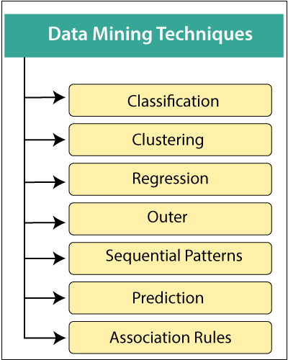
Unit - II
Dr. G.Manikandan
ACP/School of Computing
SASTRA Deemed University

Slide 2
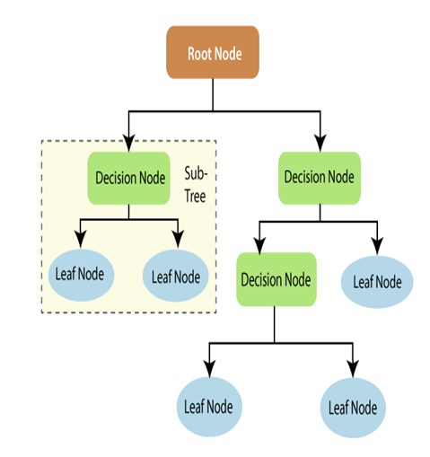
Classification
Classification:
Decision Tree Induction

Slide 3
Decision Tree Components
Forecast whether the match will be played or not according to the weather condition.
Root Node:
Represents the entire dataset and serves as the starting point for splitting.
Internal Nodes:
Represent decisions based on attributes (e.g., “Is it raining?”).
Branches:
Indicate possible outcomes of decisions (e.g., “Yes” or “No”).
Leaf Nodes:
Represent final outcomes or classifications (e.g., “Play tennis” or “Don’t play tennis”).

Slide 4
Types
Classification Trees:
Used when the target variable is categorical.
For example, predicting whether an email is spam or not spam.
Regression Trees:
Used when the target variable is continuous, like predicting house prices.

Slide 5
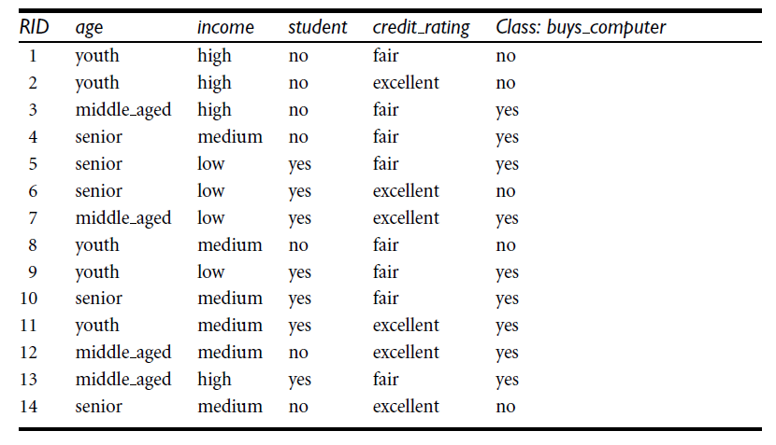
Decision Tree Induction: An Example
Training data set: Buys_computer

Slide 6
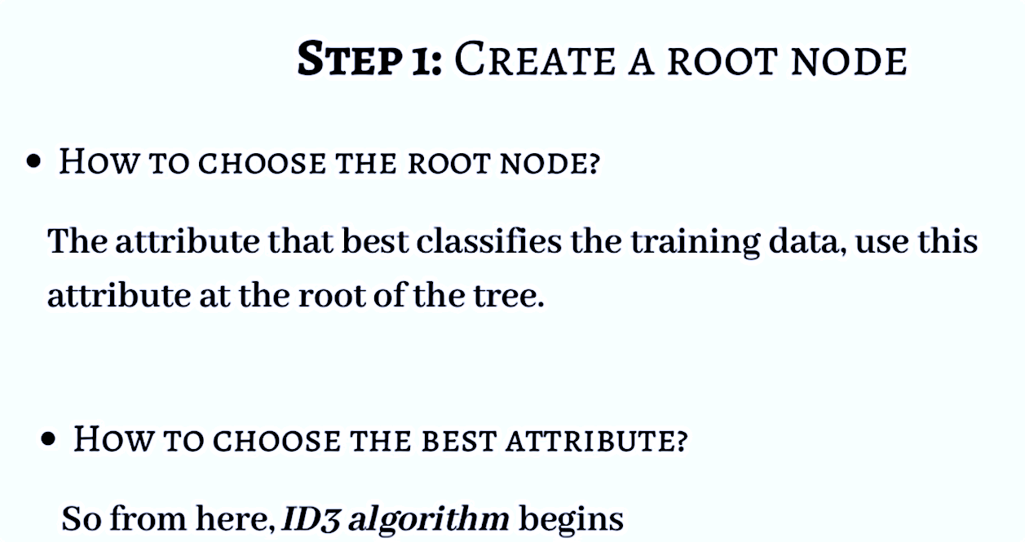
ID3(Iterative Dichotomiser 3) Algorithm
Age
Income
Student
Credit_rating

Slide 7
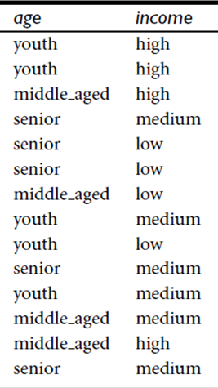
Procedure

Slide 8
ID3(Iterative Dichotomiser 3) Algorithm
Entropy
It is used for checking the impurity or uncertainty present in the data.
Entropy is used to evaluate the quality of a split.
When entropy is zero the sample is completely homogeneous, meaning that each instance belongs to the same class and
Entropy is one when the sample is equally divided between different classes.
Information Gain
Information gain indicates how much information a particular feature/ variable give us about the final outcome.

Slide 9
ID3 Algorithm
ID3 uses information gain as its attribute selection measure.
This measure is based on pioneering work by Claude Shannon on information theory, which studied the value or “information content” of messages.
Let node N represent or hold the tuples of partition D.
The attribute with the highest information gain is chosen as the splitting attribute for node N.
This attribute minimizes the information needed to classify the tuples in the resulting partitions and reflects the least randomness or “impurity” in these partitions.
Such an approach minimizes the expected number of tests needed to classify a given tuple and guarantees that a simple (but not necessarily the simplest) tree is found.
INT303R01 - Data Warehousing and Data Mining

Slide 10
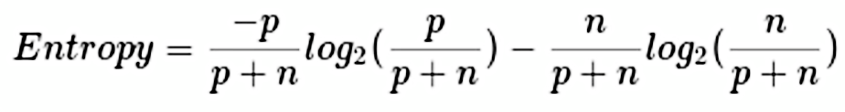
ID3 Algorithm
Expected information (entropy) needed to classify a tuple in D:
(or)

Slide 11
ID3 Algorithm
Now, suppose we were to partition the tuples in D on some attribute A having v distinct values, {a1, a2, … , a_{v}}, as observed from the training data.
If A is discrete-valued, these values correspond directly to the v outcomes of a test on A.
Attribute A can be used to split D into v partitions or subsets, {D1, D2,… , Dv}, where Dj contains those tuples in D that have outcome aj of A.
These partitions would correspond to the branches grown from node N.
Ideally, we would like this partitioning to produce an exact classification of the tuples.
That is, we would like for each partition to be pure.
However, it is quite likely that the partitions will be impure (e.g., where a partition may contain a collection of tuples from different classes rather than from a single class).
INT303R01 - Data Warehousing and Data Mining

Slide 12
ID3 Algorithm
How much more information would we still need (after the partitioning) to arrive at an exact classification?
This amount is measured by
Information needed (after using A to split D into v partitions) to classify D:

Slide 13
ID3 Algorithm
Information gain is defined as the difference between the original information requirement (i.e., based on just the proportion of classes) and the new requirement (i.e., obtained after partitioning on A).
Information gained by branching on attribute A
INT303R01 - Data Warehousing and Data Mining

Slide 14
Entropy Answers
Buys_computer
No
No
Yes
Yes
Yes
No
Yes
No
Yes
Yes
Yes
Yes
Yes
No

Slide 15
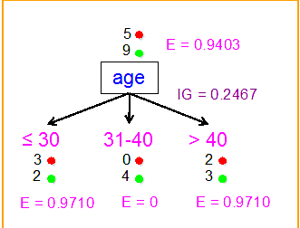
Entropy Answers
 | Age | Buys_computer
D1 | <=30 | No
D2 | <=30 | No
D8 | <=30 | No
D9 | <=30 | Yes
D11 | <=30 | Yes
<=30 – Youth
31..40 – Middle Aged
>40 - Senior
 | Age | Buys_computer
D3 | 31..40 | Yes
D7 | 31..40 | Yes
D12 | 31..40 | Yes
D13 | 31..40 | Yes
 | Age | Buys_computer
D4 | >40 | Yes
D5 | >40 | Yes
D6 | >40 | No
D10 | >40 | Yes
D14 | >40 | No

Slide 16
Entropy Answers
Gain(A)=0.940 – 0.693
Gain(A)=0.246

Slide 17
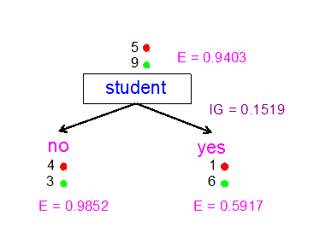
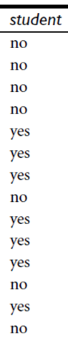
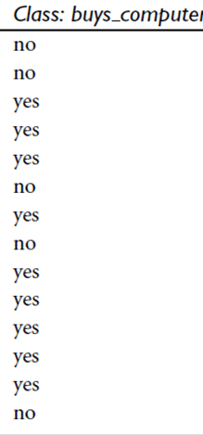
Entropy Answers
0.789

Slide 18
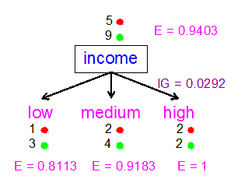
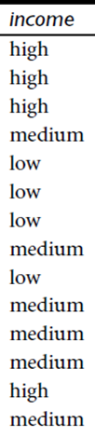
Entropy Answers

Slide 19
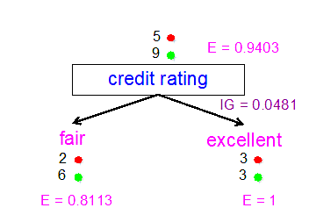
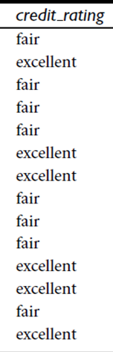
Entropy Answers

Slide 20
Entropy Answers

Slide 21
Entropy Answers
Information Gain (Age) =0.246
Information Gain (Income) =0.029
Information Gain (Student) = 0.151
Information Gain (credit_rating) =0.048

Slide 22
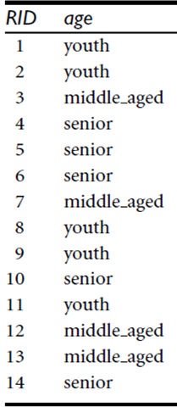
Select Age

Slide 23
Building The Tree: “age” as the root

Slide 24
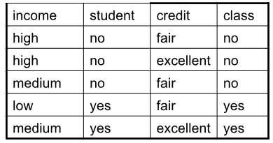
Further Split
 | Age | Buys_computer
D1 | <=30 | No
D2 | <=30 | No
D8 | <=30 | No
D9 | <=30 | Yes
D11 | <=30 | Yes
Age<=30:
Entropy I(2,3)= -2/5 log₂(2/5) – 3/5 log₂(3/5) = 0.97

Slide 25
Further Split
For Income we have three values income_high (0 yes and 2 no), income_medium (1 yes and 1 no) and income_low (1 yes and 0 no)
For Student we have two values student_yes (2 yes and 0 no) and student_no (0 yes 3 no)

Slide 26
Further Split
For Student we have two values credit_fair (1 yes and 2 no) and credit_excellent (1 yes 1 no)
Gain (Credit_rating) – 0.0192
Information Gain (Income) =0.57
Information Gain (Student) = 0.97
Information Gain (credit_rating) = 0.0192
INT303R01 - Data Warehousing and Data Mining

Slide 27
Next Level Tree

Slide 28
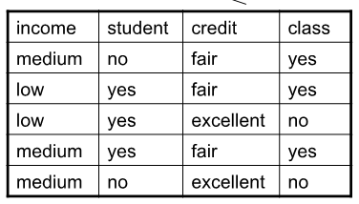
Further split >40
 | Age | Buys_computer
D4 | >40 | Yes
D5 | >40 | Yes
D6 | >40 | No
D10 | >40 | Yes
D14 | >40 | No
Entropy age >40:
Entropy I(3,2)= -3/5 log₂(3/5) – 2/5 log₂(2/5) = 0.97

Slide 29
Further split >40
For Income we have two values income_medium (2 yes and 1 no) and income_low (1 yes and 1 no)
For Student we have two values student_yes (2 yes and 1 no) and student_no (1 yes and 1 no)

Slide 30
Further split >40
For Credit_Rating we have two values credit_rating fair (3 yes and 0 no) and credit_rating excellent (0 yes and 2 no)
Information Gain (Income) =0.02
Information Gain (Student) = 0.02
Information Gain (credit_rating) = 0.97

Slide 31
Further split >40
INT303R01 - Data Warehousing and Data Mining

Slide 32
Resultant Decision Tree
age?
<=30
overcast
>40
31..40
student?
yes
credit rating?
no
yes
excellent
fair
no
yes
no
yes

Slide 33
References
https://medium.com/@ashirbadpradhan8115/decision-tree-id3-algorithm-machine-learning

Slide 34


